Slide 1
Course Outline
MODEL INFORMATION
COMPLETE
INCOMPLETE
Bayes Decision Theory
Supervised Learning
Unsupervised Learning
Parametric Approach
Nonparametric Approach
Parametric Approach
Nonparametric Approach
“Optimal” Rules
Plug-in Rules
Density Estimation
Geometric Rules (K-NN, MLP)
Mixture Resolving
Cluster Analysis (Hard, Fuzzy)

Slide 2
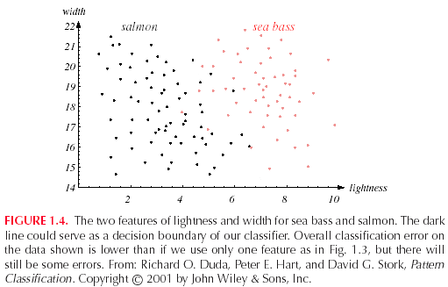
Two-dimensional Feature Space
Supervised Learning

Slide 3
Chapter 3:
Maximum-Likelihood & Bayesian Parameter Estimation
Introduction
Maximum-Likelihood Estimation
Bayesian Estimation
Curse of Dimensionality
Component analysis & Discriminants
EM Algorithm

Slide 4
Introduction
  Bayesian framework
    We could design an optimal classifier if we knew:
      P(ω_{i}) : priors
      P(x | ω_{i}) : class-conditional densities
    Unfortunately, we rarely have this complete information!
  Design a classifier based on a set of labeled training samples (supervised learning)
    Assume priors are known
    Need sufficient no. of training samples for estimating class-conditional densities, especially when the dimensionality of the feature space is large
Pattern Classification, Chapter 3
1

Slide 5
  Assumption about the problem: parametric model of P(x | ω_{i}) is available
  Assume P(x | ω_{i}) is multivariate Gaussian
    P(x | ω_{i}) ~ N( μ_{i}, Σ_{i})
    Characterized by 2 parameters
  Parameter estimation techniques
    Maximum-Likelihood (ML) and Bayesian estimation
    Results of the two procedures are nearly identical, but there is a subtle difference
Pattern Classification, Chapter 3
1

Slide 6
    In ML estimation parameters are assumed to be fixed but unknown! Bayesian parameter estimation procedure, by its nature, utilizes whatever prior information is available about the unknown parameter
    MLE: Best parameters are obtained by maximizing the probability of obtaining the samples observed
    Bayesian methods view the parameters as random variables having some known prior distribution; How do we know the priors?
    In either approach, we use P(ω_{i} | x) for our classification rule!
Pattern Classification, Chapter 3
1

Slide 7
Maximum-Likelihood Estimation
    Has good convergence properties as the sample size increases; estimated parameter value approaches the true value as n increases
    Simpler than any other alternative technique
  General principle
    Assume we have c classes and
    P(x | ω_{j}) ~ N( μ_{j}, Σ_{j})
    P(x | ω_{j}) ≡ P (x | ω_{j}, θ_{j}), where
Use class ω_{j} samples to estimate class ω_{j} parameters
Pattern Classification, Chapter 3
2

Slide 8
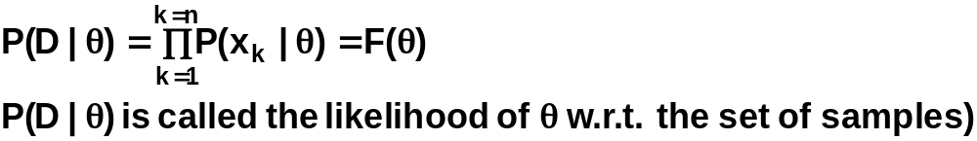

    Use the information in training samples to estimate
    θ = (θ₁, θ₂, …, θ_{c}); θ_{i} (i = 1, 2, …, c) is associated with the ith category
    Suppose sample set D contains n iid samples, x₁, x₂,…, x_{n}
    ML estimate of θ is, by definition, the value that maximizes P(D | θ)
    “It is the value of θ that best agrees with the actually observed training samples”
Pattern Classification, Chapter 3
2

Slide 9
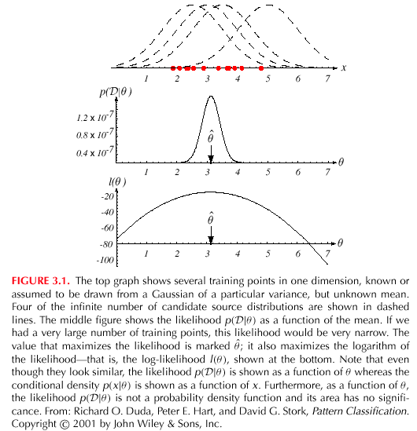
Pattern Classification, Chapter 3
2

Slide 10
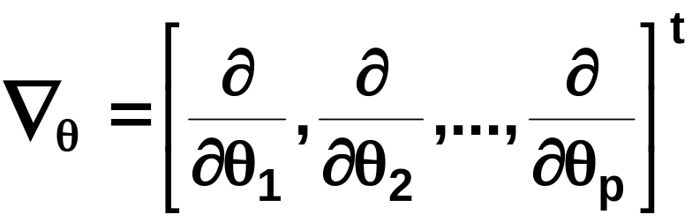
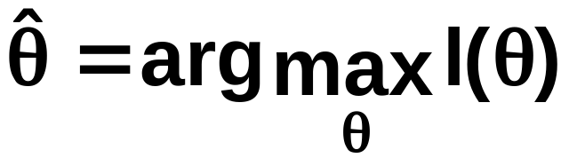
    Optimal estimation
      Let θ = (θ₁, θ₂, …, θ_{p})^{t} and ∇_{θ} be the gradient operator
      We define l(θ) as the log-likelihood function
      l(θ) = ln P(D | θ)
      New problem statement:
      determine θ that maximizes the log-likelihood
Pattern Classification, Chapter 3
2

Slide 11
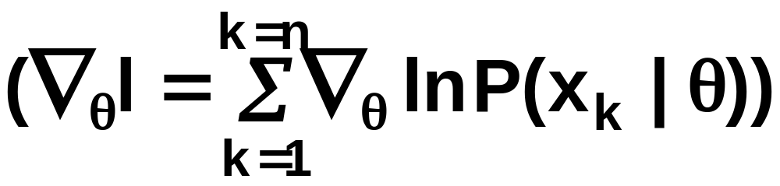
    Set of necessary conditions for an optimum is:
    ∇_{θ}l = 0
Pattern Classification, Chapter 3
2

Slide 12
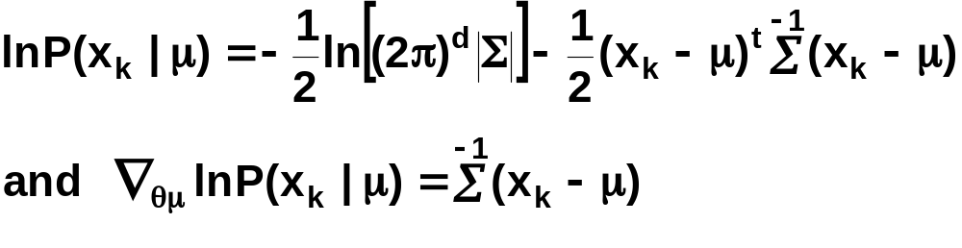
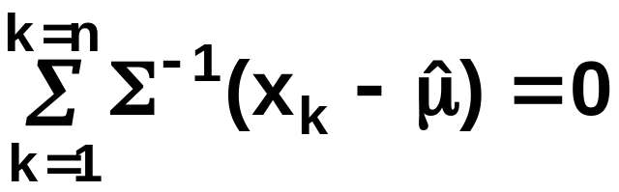
Example of a specific case: unknown μ
  P(x | μ) ~ N(μ, Σ)
  (Samples are drawn from a multivariate normal population)
  θ = μ, therefore the ML estimate for μ must satisfy:
Pattern Classification, Chapter 3
2

Slide 13
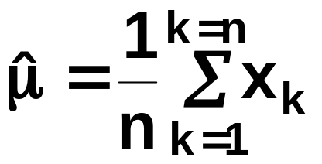
    Multiplying by Σ and rearranging, we obtain:
    which is the arithmetic average or the mean of the samples of the training samples!
Conclusion:
    Given P(x_{k} | ω_{j}), j = 1, 2, …, c to be Gaussian in a d-dimensional feature space, estimate the vector θ = (θ₁, θ₂, …, θ_{c})^{t} and perform a classification using the Bayes decision rule of chapter 2!
Pattern Classification, Chapter 3
2

Slide 14
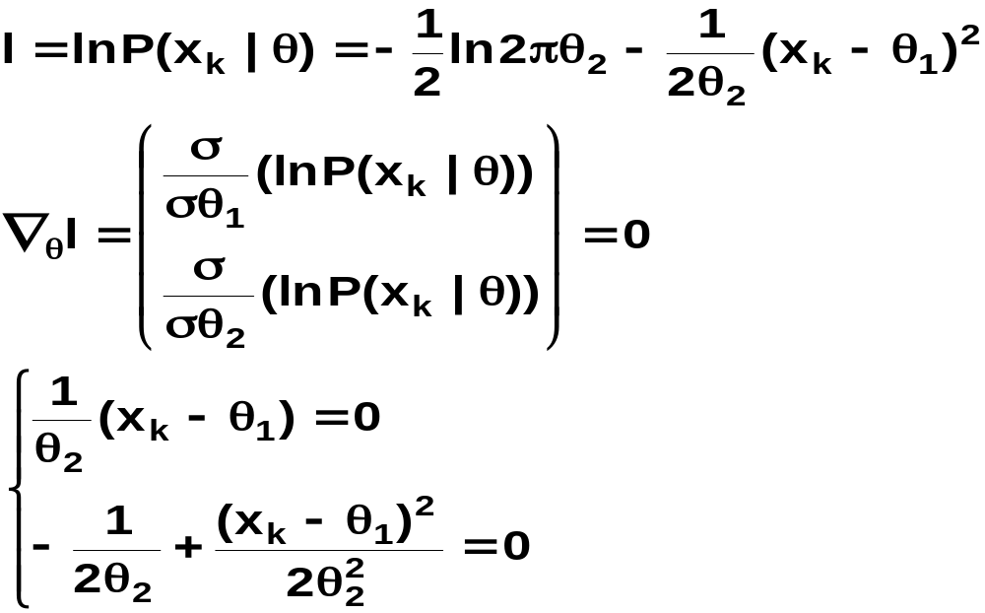
ML Estimation:
  Univariate Gaussian Case: unknown μ & σ
  θ = (θ₁, θ₂) = (μ, σ²)
Pattern Classification, Chapter 3
2

Slide 15
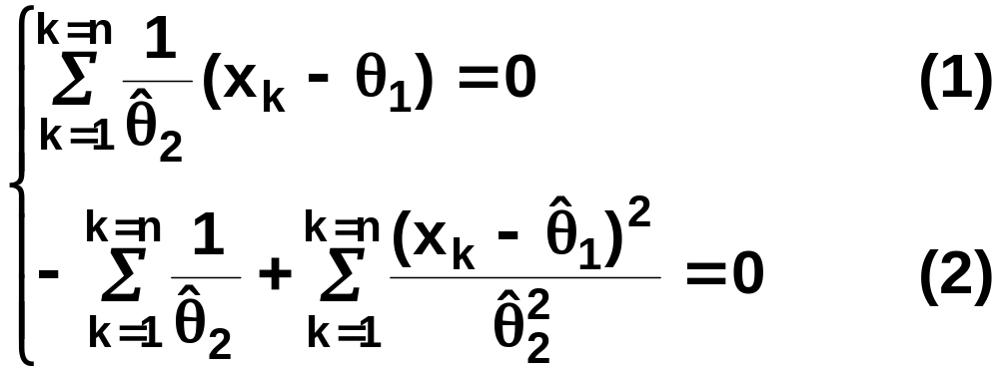
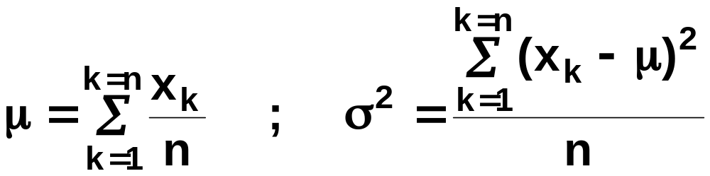
Summation:
Combining (1) and (2), one obtains:
Pattern Classification, Chapter 3
2

Slide 16
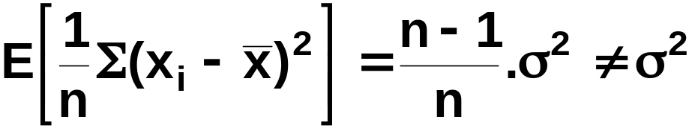
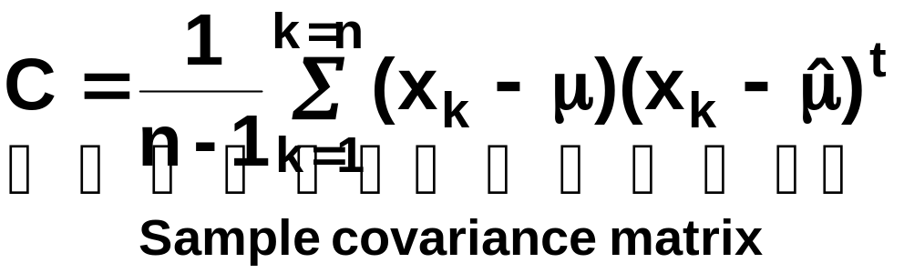
Bias
  ML estimate for σ² is biased
  An unbiased estimator for Σ is:
Pattern Classification, Chapter 3
2

Slide 17
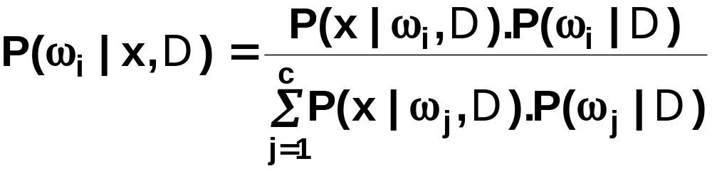
Bayesian Estimation (Bayesian learning approach for pattern classification problems)
  In MLE θ was supposed to have a fixed value
  In BE θ is a random variable
  The computation of posterior probabilities P(ω_{i} | x) lies at the heart of Bayesian classification
  Goal: compute P(ω_{i} | x, D)
  Given the training sample set D, Bayes formula can be written
Pattern Classification, Chapter 1
3

Slide 18
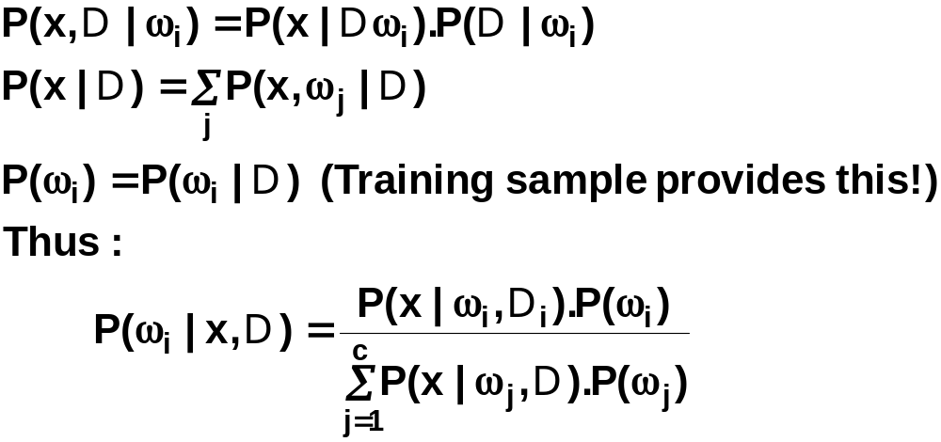
To demonstrate the preceding equation, use:
Pattern Classification, Chapter 1
3

Slide 19
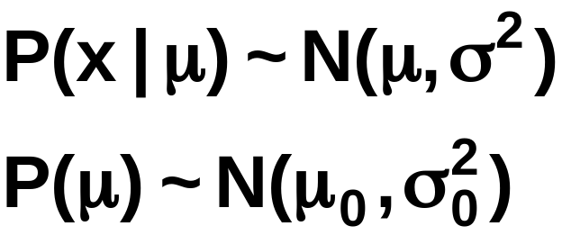
Bayesian Parameter Estimation: Gaussian Case
Goal: Estimate θ using the a-posteriori density P(θ | D)
  The univariate Gaussian case: P(μ | D)
  μ is the only unknown parameter
  μ₀ and σ₀ are known!
Pattern Classification, Chapter 1
4

Slide 20
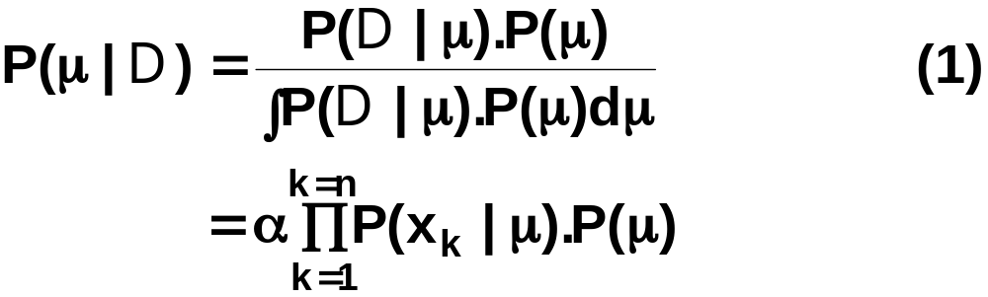
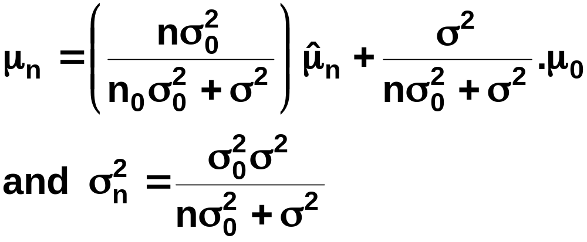
  Reproducing density
  The updated parameters of the prior:
Pattern Classification, Chapter 1
4

Slide 21
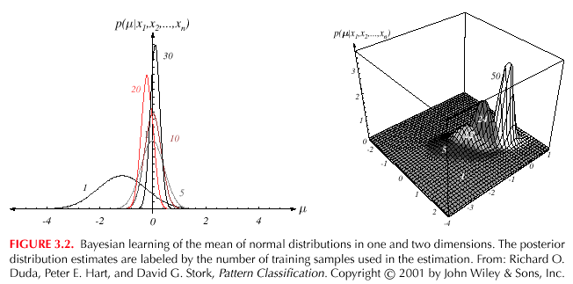
Pattern Classification, Chapter 1
4

Slide 22
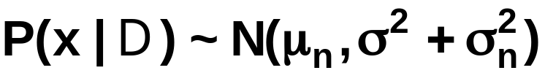
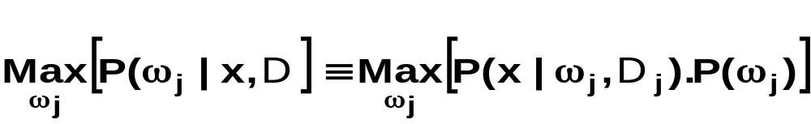
  The univariate case P(x | D)
    P(μ | D) has been computed
    P(x | D) remains to be computed!
    It provides:
    Desired class-conditional density P(x | D_{j}, ω_{j})
    P(x | D_{j}, ω_{j}) together with P(ω_{j}) and using Bayes formula, we obtain the Bayesian classification rule:
Pattern Classification, Chapter 1
4

Slide 23
Bayesian Parameter Estimation: General Theory
  P(x | D) computation can be applied to any situation in which the unknown density can be parametrized: the basic assumptions are:
    The form of P(x | θ) is assumed known, but the value of θ is not known exactly
    Our knowledge about θ is assumed to be contained in a known prior density P(θ)
    The rest of our knowledge about θ is contained in a set D of n random variables x₁, x₂, …, x_{n} that follows P(x)
Pattern Classification, Chapter 1
5

Slide 24
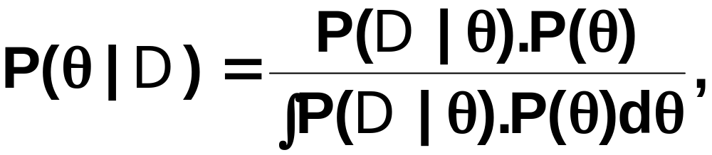
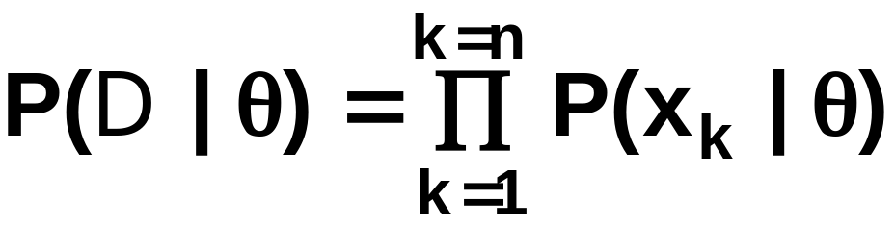
The basic problem is:
“Compute the posterior density P(θ | D)”
then “Derive P(x | D)”
Using Bayes formula, we have:
And by independence assumption:
Pattern Classification, Chapter 1
5

Slide 25
Overfitting

Slide 26
Problem of Insufficient Data
How to train a classifier (e.g., estimate the covariance matrix) when the training set size is small (compared to the number of features)
Reduce the dimensionality
  Select a subset of features
  Combine available features to get a smaller number of more “salient” features.
Bayesian techniques
  Assume a reasonable prior on the parameters to compensate for small amount of training data
Model Simplification
  Assume statistical independence
Heuristics
  Threshold the estimated covariance matrix such that only correlations above a threshold are retained.

Slide 27
Practical Observations
Most heuristics and model simplifications are almost surely incorrect
In practice, however, the performance of the classifiers base don model simplification is better than with full parameter estimation
Paradox: How can a suboptimal/simplified model perform better than the MLE of full parameter set, on test dataset?
  The answer involves the problem of insufficient data

Slide 28
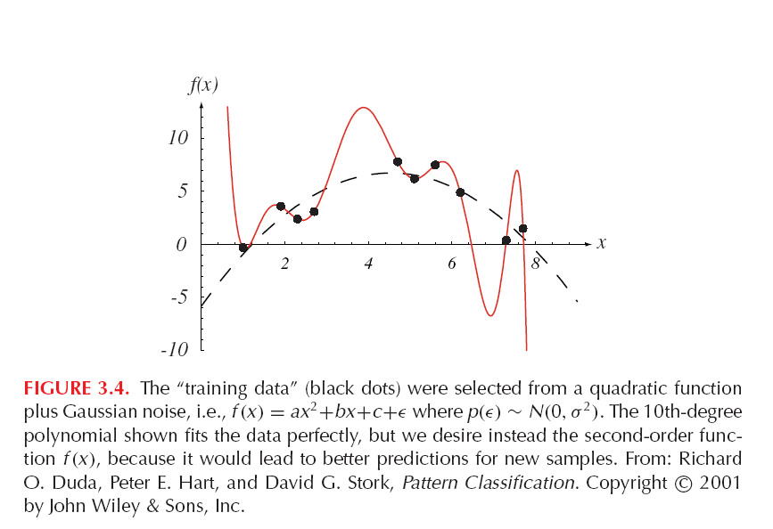
Insufficient Data in Curve Fitting

Slide 29
Curve Fitting Example (contd)
The example shows that a 10th-degree polynomial fits the training data with zero error
  However, the test or the generalization error is much higher for this fitted curve
When the data size is small, one cannot be sure about how complex the model should be
A small change in the data will change the parameters of the 10th-degree polynomial significantly, which is not a desirable quality; stability

Slide 30
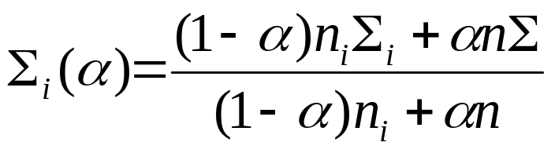
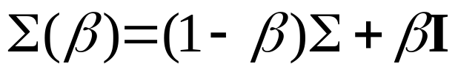
Handling insufficient data
Heuristics and model simplifications
Shrinkage is an intermediate approach, which combines “common covariance” with individual covariance matrices
  Individual covariance matrices shrink towards a common covariance matrix.
  Also called regularized discriminant analysis
Shrinkage Estimator for a covariance matrix, given shrinkage factor 0 < α < 1,
Further, the common covariance can be shrunk towards the Identity matrix,

Slide 31
Problems of Dimensionality

Slide 32
Introduction
Real world applications usually come with a large number of features
  Text in documents is represented using frequencies of tens of thousands of words
  Images are often represented by extracting local features from a large number of regions within an image
Naive intuition: more the number of features, the better the classification performance? – Not always!
There are two issues that must be confronted with high dimensional feature spaces
  How does the classification accuracy depend on the dimensionality and the number of training samples?
  What is the computational complexity of the classifier?

Slide 33

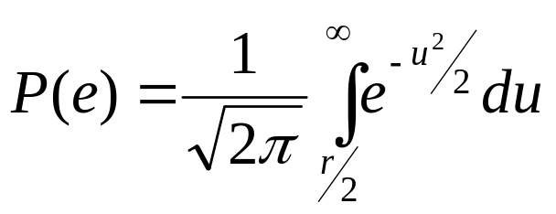
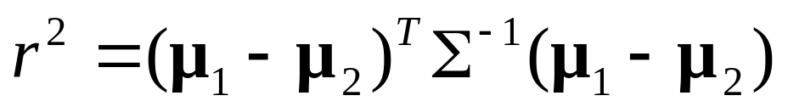
Statistically Independent Features
If features are statistically independent, it is possible to get excellent performance as dimensionality increases
For a two class problem with multivariate normal classes , and equal prior probabilities, the probability of error is
where the Mahalanobis distance is defined as

Slide 34
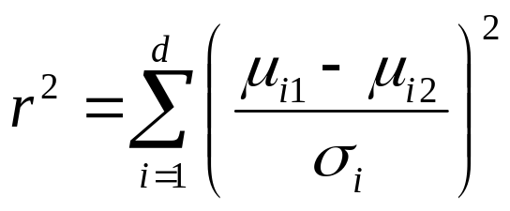
Statistically Independent Features
When features are independent, the covariance matrix is diagonal, and we have
Since r² increases monotonically with an increase in the number of features, P(e) decreases
As long as the means of features in the differ, the error decreases

Slide 35
Increasing Dimensionality
If a given set of features does not result in good classification performance, it is natural to add more features
High dimensionality results in increased cost and complexity for both feature extraction and classification
If the probabilistic structure of the problem is completely known, adding new features will not possibly increase the Bayes risk

Slide 36
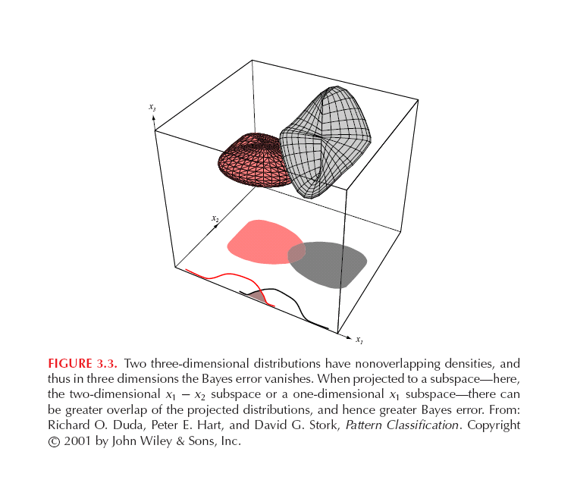

Slide 37
Curse of Dimensionality
In practice, increasing dimensionality beyond a certain point in the presence of finite number of training samples often leads to lower performance, rather than better performance
The main reasons for this paradox are as follows:
  the Gaussian assumption, that is typically made, is almost surely incorrect
  Training sample size is always finite, so the estimation of the class conditional density is not very accurate
Analysis of this “curse of dimensionality” problem is difficult

Slide 38
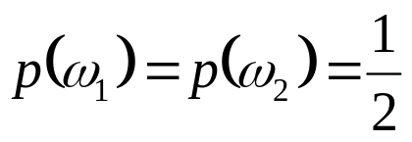

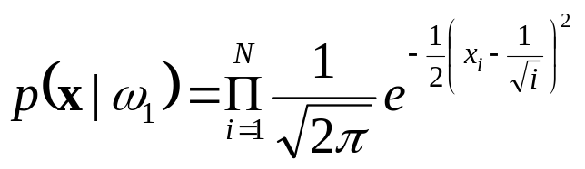



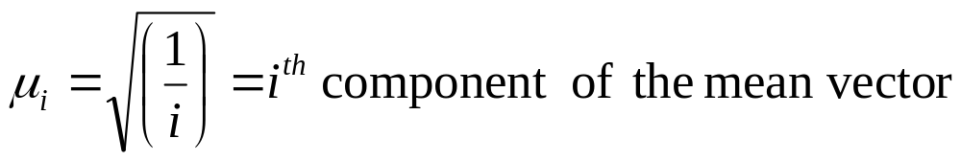
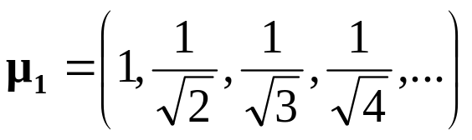
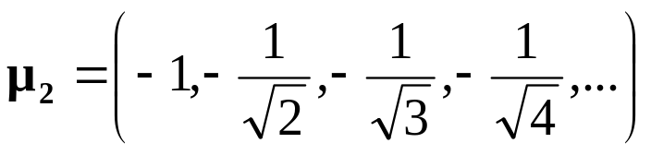
A Simple Example
Trunk (PAMI, 1979) provided a simple example illustrating this phenomenon.
N: Number of features

Slide 39
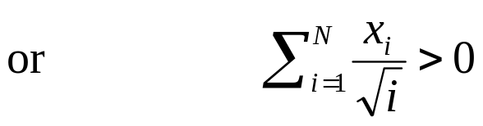
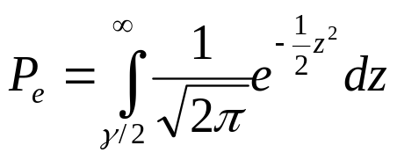
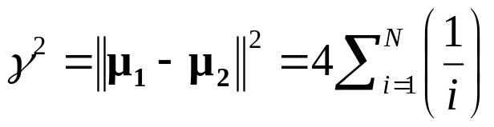
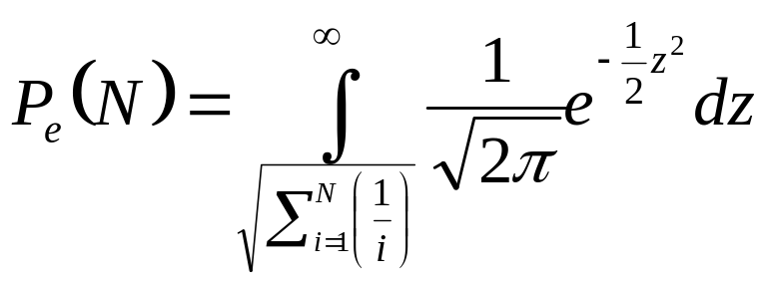
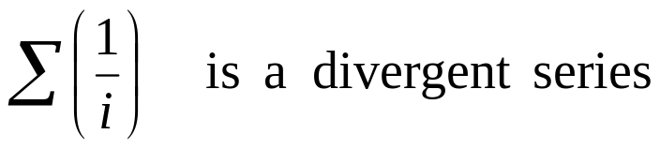

Case 1: Mean Values Known
Bayes decision rule:

Slide 40
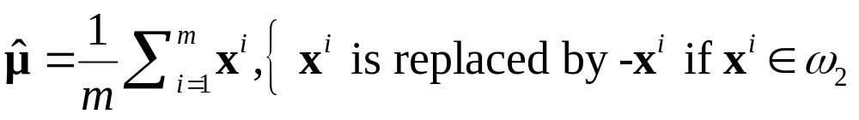
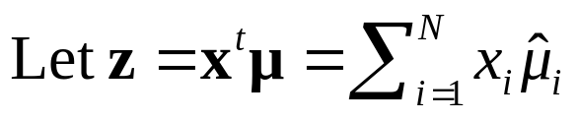
Case 2: Mean Values Unknown
m labeled training samples are available
POOLED ESTIMATE
Plug-in decision rule

Slide 41
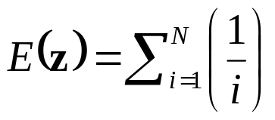
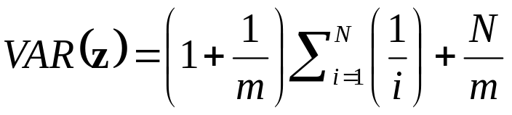
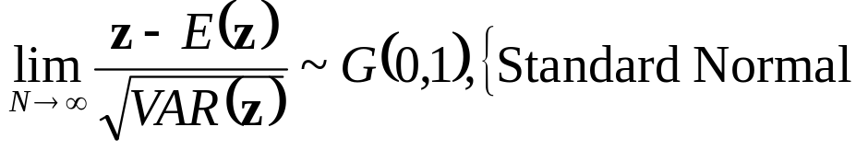
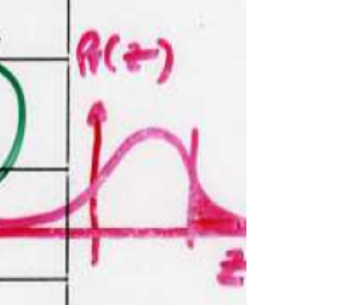
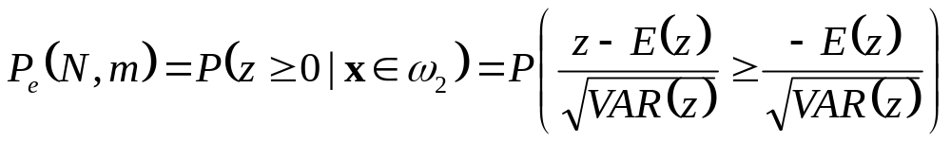
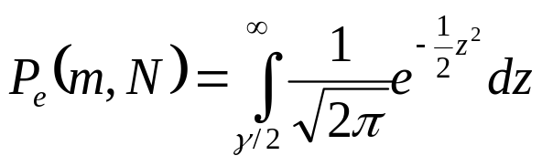
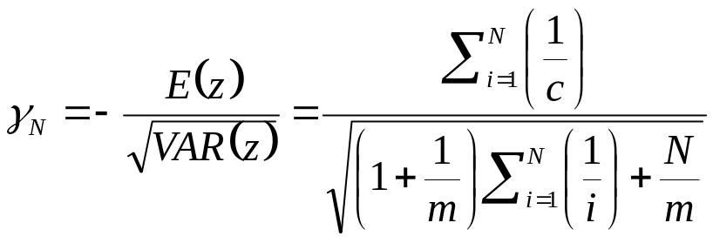


Case 2: Mean Values Unknown

Slide 42
Case 2: Mean Values Unknown

Slide 43
Component Analysis and Discriminants
  Combine features in order to reduce the dimension of the feature space
  Linear combinations are simple to compute and tractable
  Project high dimensional data onto a lower dimensional space
  Two classical approaches for finding “optimal” linear transformation
    PCA (Principal Component Analysis) “Projection that best represents the data in a least- square sense”
    MDA (Multiple Discriminant Analysis) “Projection that best separates the data in a least-squares sense”
Pattern Classification, Chapter 1
8

